Slide 1
ECS
Containerization

Slide 2
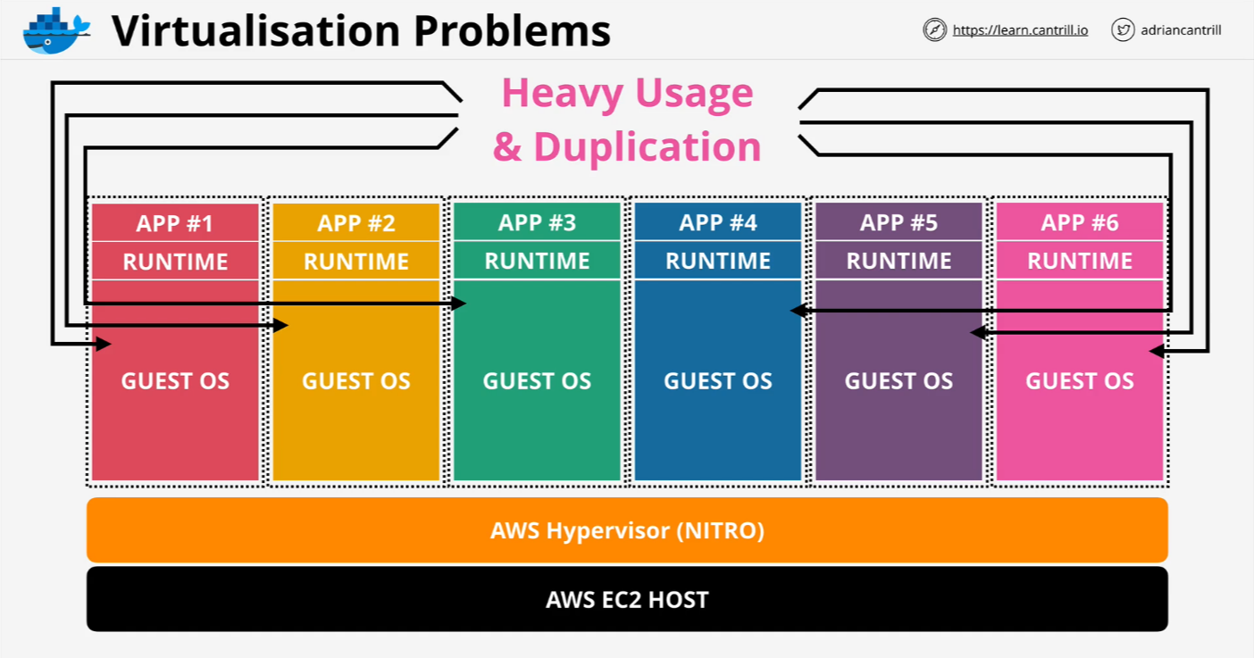
Virtualization Problem

Slide 3
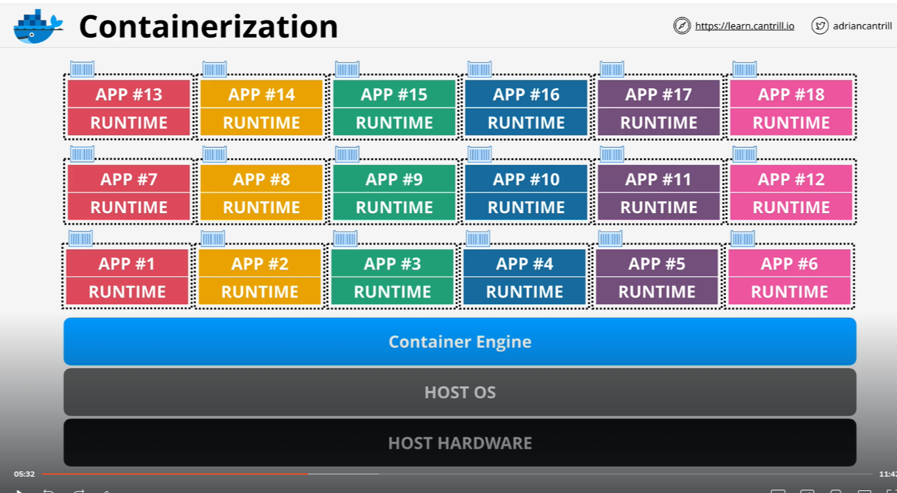
Containerization

Slide 4
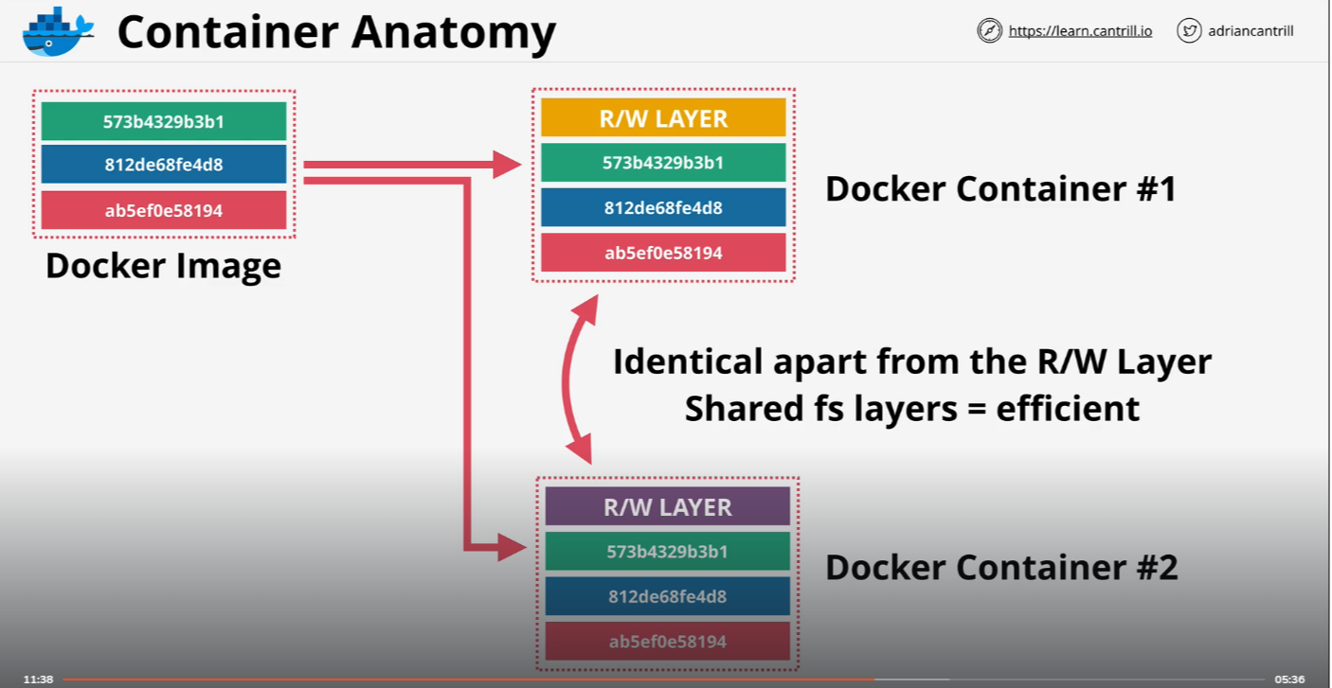
Container Anatomy

Slide 5
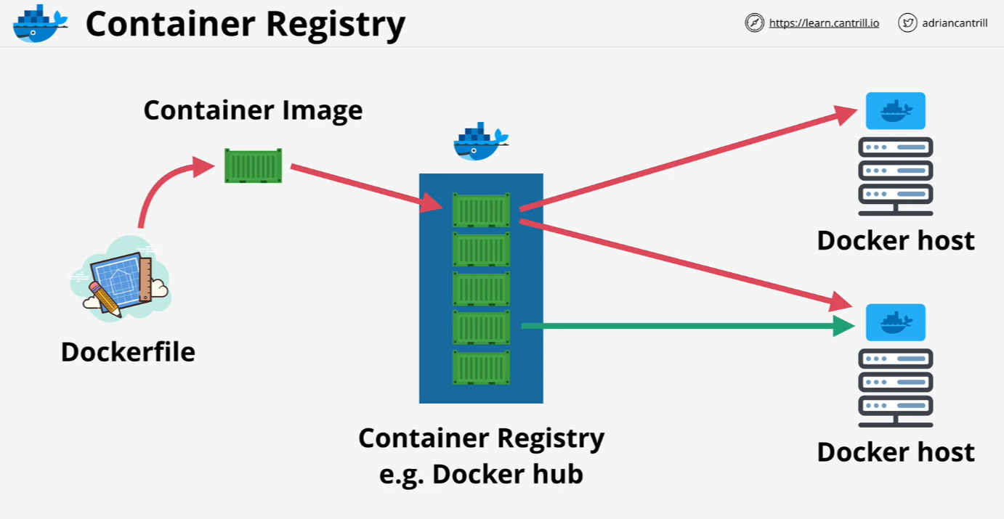
Container Registry

Slide 6
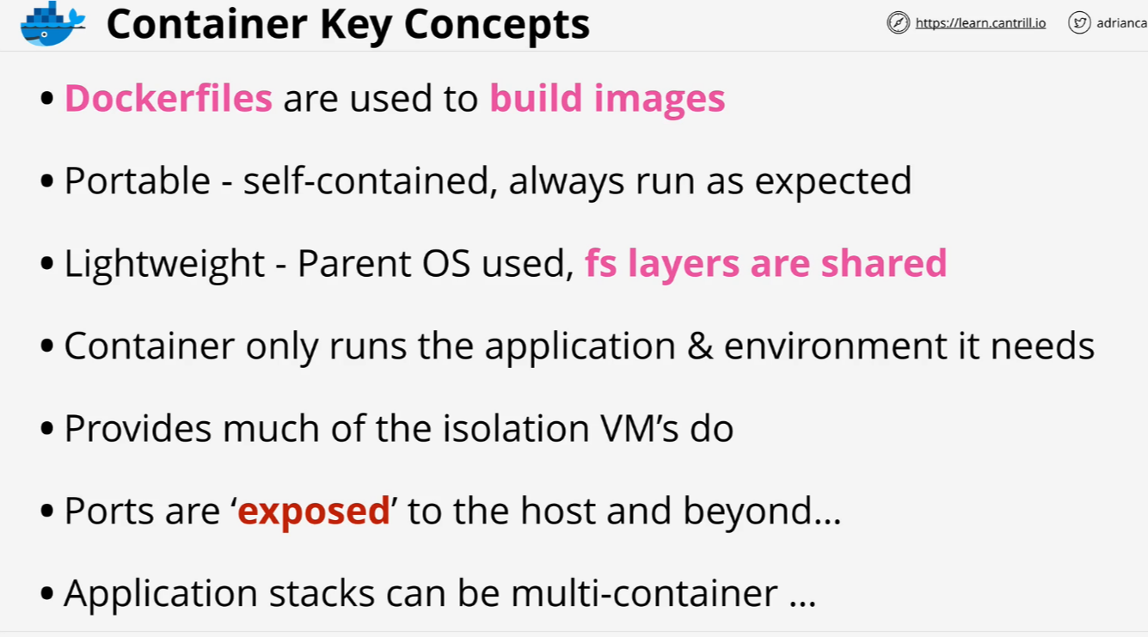
Container Key Concept

Slide 7
Creating 'container of cats' Docker Image
We’ll create required services with CloudFormation template.
Then with these commands we’ll create docker image and upload to DockerHub.
https://learn-cantrill-labs.s3.amazonaws.com/awscoursedemos/0030-aws-associate-ec2docker/lesson_commands_AL2023.txt

Slide 8
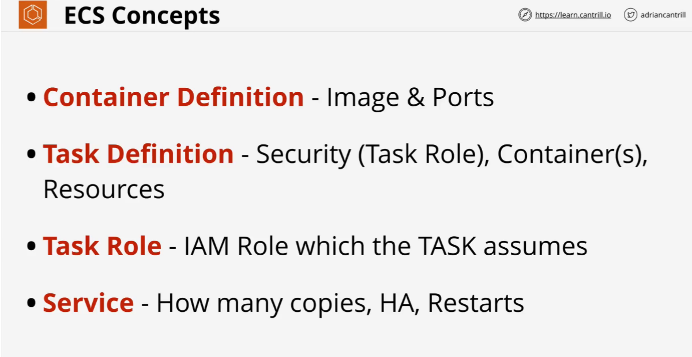
ECS

Slide 9
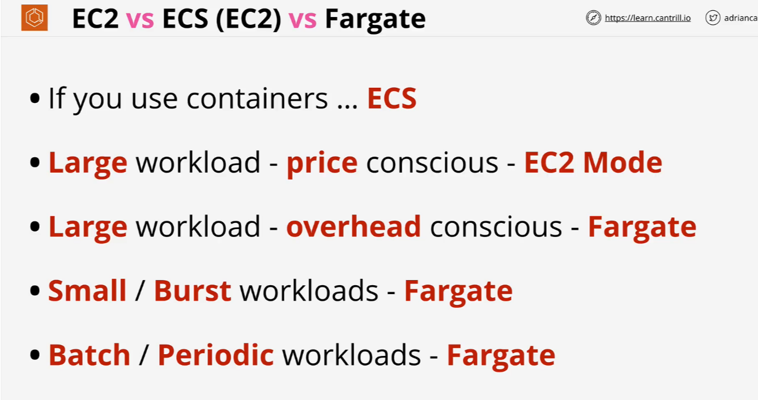
ECS (EC2 vs Fargate)

Slide 10
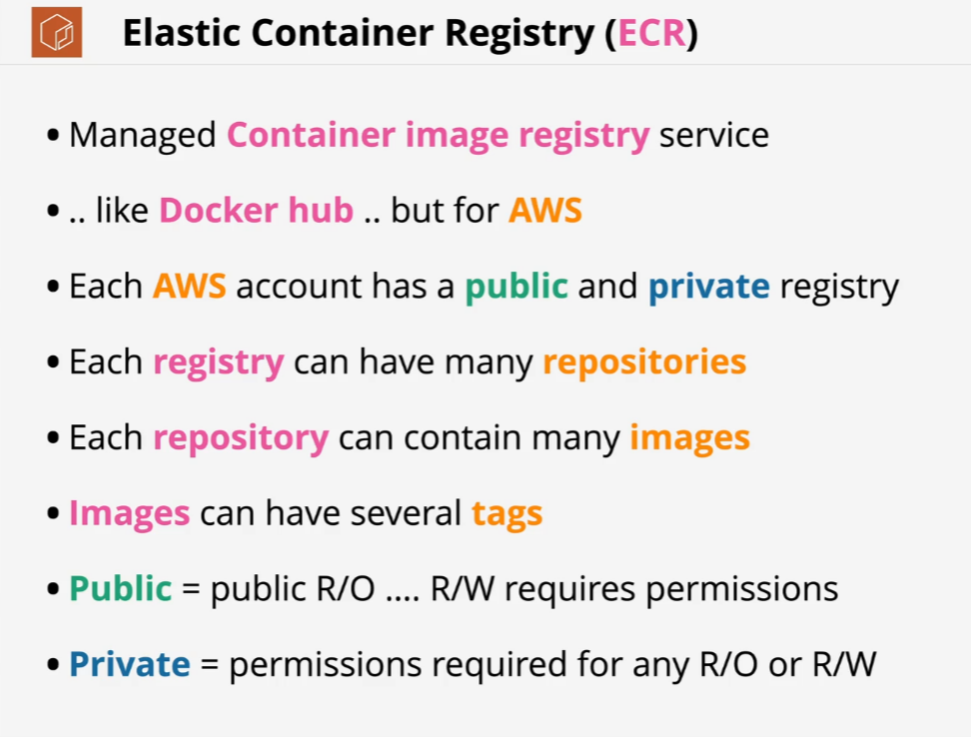
Elastic Container Registry (ECR)

Slide 11
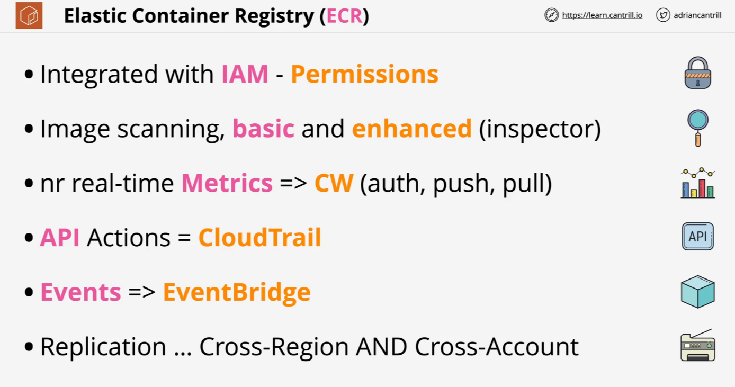
Elastic Container Registry (ECR)

Slide 12
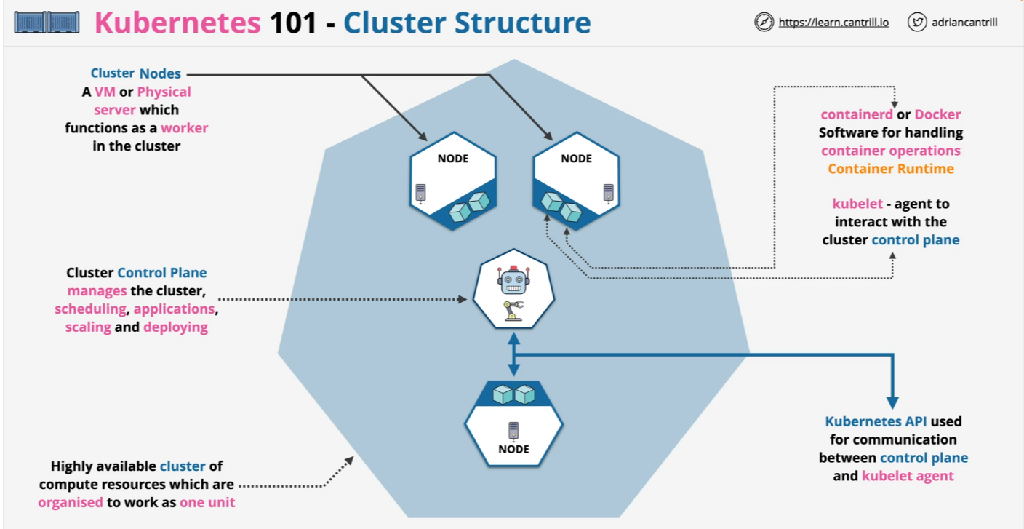
Kubernetes - Cluster Structure

Slide 13
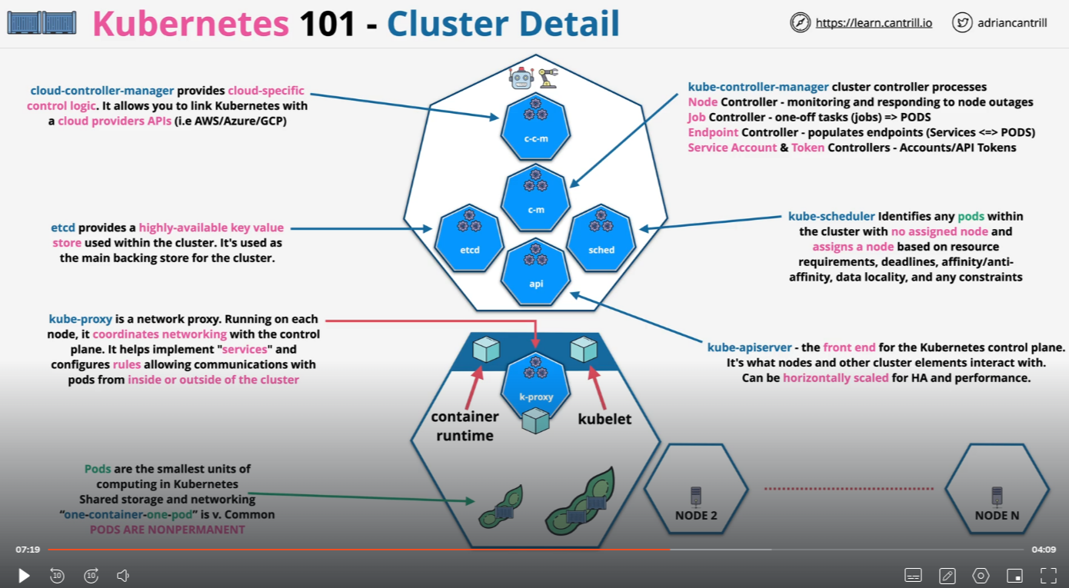
Kubernetes – Cluster Detail

Slide 14
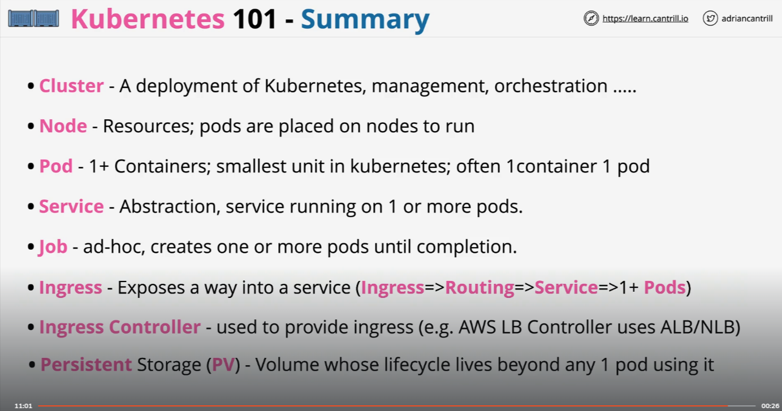
Kubernetes - Summary

Slide 15
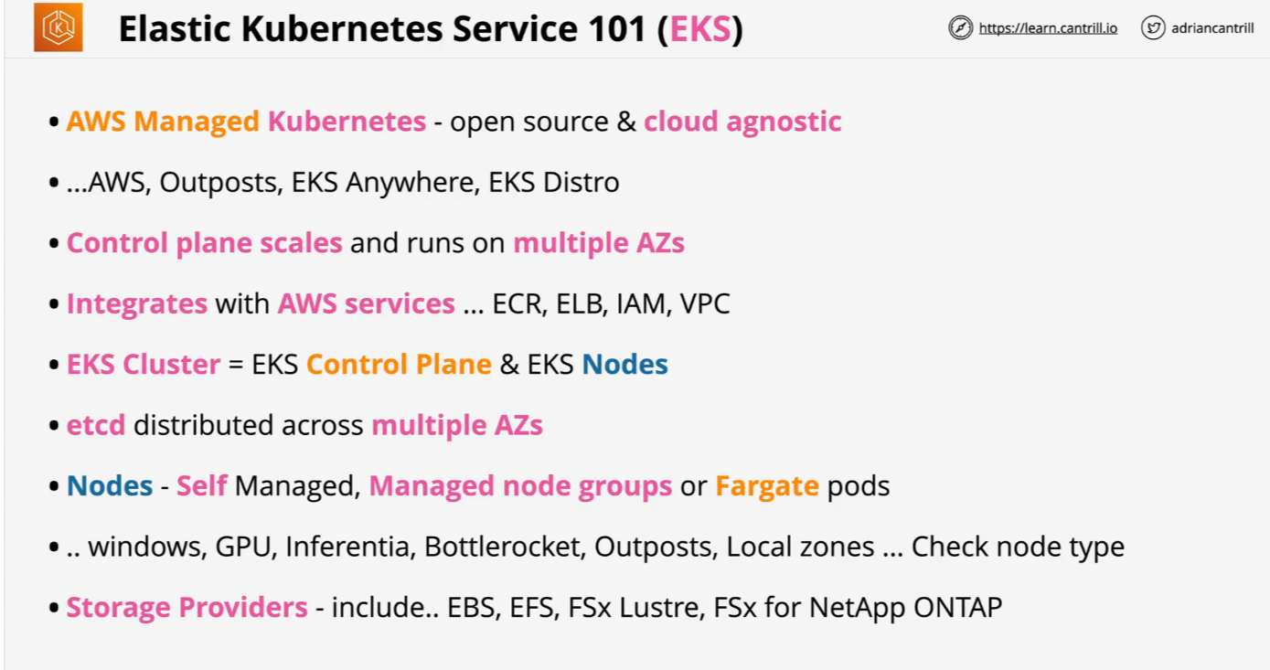
Elastic Kubernetes Service (EKS)

